Slide 1

Data and psychology of Speed Dating
Devon Jarquin
MSDS 696
Data Science Practicum II

Slide 2
Purpose
The purpose of this practicum is to use machine learning and analytics to get a better understanding if there’s any links between the demographics, psychology and if there was a connection
I would like to get as much insight as possible from my data and make as many calculations as I can and to test where there were matches and no matches
I will be looking at demographics, interests and survey responses of the individuals that partook in the speed dating experiment

Slide 3
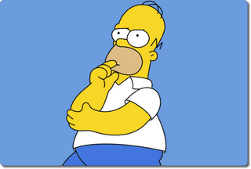
Method
My approach is to gain as much insight as I can from this data and trace it all back to whether or not that specific circumstance was a match
First step is to clean the data and prepare it to be analyzed
Second step is break the data into appropriate groups to make our analyzing as efficient as possible.
Once we have our data grouped and cleaned, then we can begin our machine learning methods and analyzing
K means Clustering
Random Forests
Data Visualization
This Photo by Unknown Author is licensed under CC BY-SA-NC
Lastly we can draw out insights and conclusion

Slide 4

Data Overview
I will be using data found: https://data.world/annavmontoya/speed-dating-experiment/workspace/file?filename=Speed+Dating+Data.csv
The data was gathered from speed dating participants from 2002-2004, during which they had four minutes to interact with someone of the opposite gender, location was not disclosed
The data found here contains:
demographics such as occupation, race, age, university attended and more.
As well as answers to questions such as how they view themselves, what their goal is for the event, how often they date, personal interests and so on.
As well as how they ranked each of their speed dating partners in terms of: attractiveness, sincerity, intelligence, how fun they appeared to be, ambitiousness, and shared interests.
The Future of Work
Troy HiltbrandMarch 23
https://tdwi.org/articles/2020/03/23/adv-all-future-of-work.aspx

Slide 5
Data Cleaning and wrangling
I broke up the data into 3 main groups, briefly mentioned before and I will be analyzing them in similar ways
The 3 groups are as follows
Demographics
Interests
Survey Responses to each date
I also cleaned the data by inserting either zeros or column averages since there were many NULL values
The Demographics subset needed both column averages and zeroes in the NULLS, and once that was performed, I bound them back together

Slide 6
Demographics Data
Once I had the demographics subset data all cleaned up and sorted out I did some machine learning and analytics
I started with K means clustering to get a better insight of what the machine grouped together from different columns
I then did the Random Forest method to see how well the machine can predict when there are matches
I then did a Variable Importance Plot from the Random Forest to see which dependent variables influenced the machine decision making

Slide 7
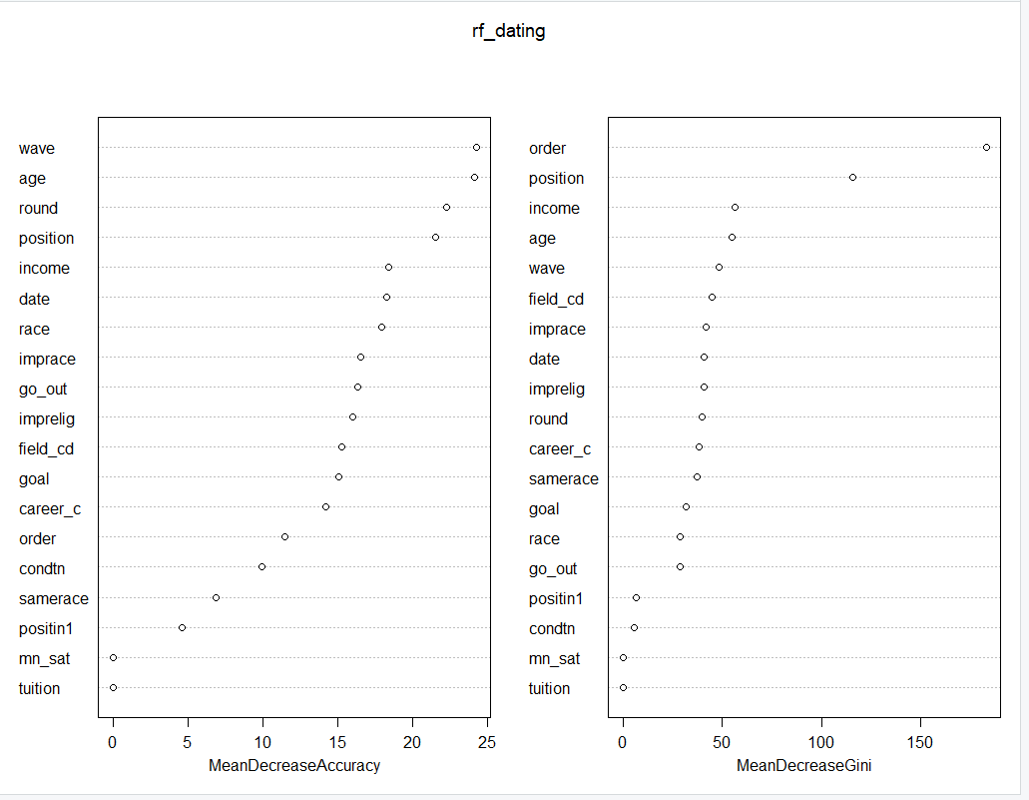
Demographics Data Results
Our Random Forest Model achieved an accuracy of 94.99%
Here are the results of the Variable of Importance Plot
These lists the variables of most importance to our machine learning random forests on the left
We can see that wave number, age and round played a huge part of our model
The chart on the right measure how much a variable impacts the gini index of our data

Slide 8
Interests
The list of activities are as follows
Sports
Tv sports
Exercise
Dining
Museums
Art
Hiking
Gaming
Clubbing
Reading
Tv
Theater
Movies
Music
Shopping
Concerts
Yoga
The next subset of data I looked at closely were the interests listed by each of the participants
The participants were given a list of 17 activities and rate on a scale of 1-10 how much they enjoy the activity
I was curious to see if certain activities drew people together more than others

Slide 9
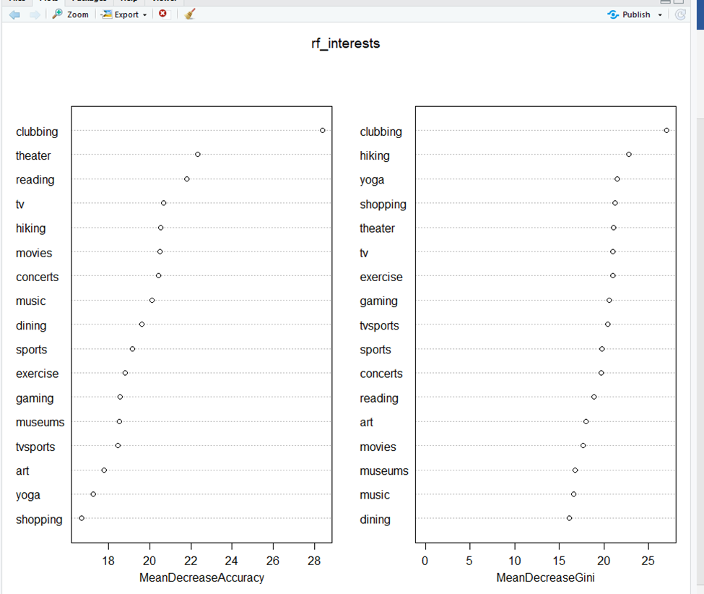
Interests
I performed a random forests and variable of importance plot to see which variables impacted our model the most
Our model yielded a 96.9% accuracy
We can see that the mean of our model is mostly impacted by clubbing, theater, reading and tv

Slide 10
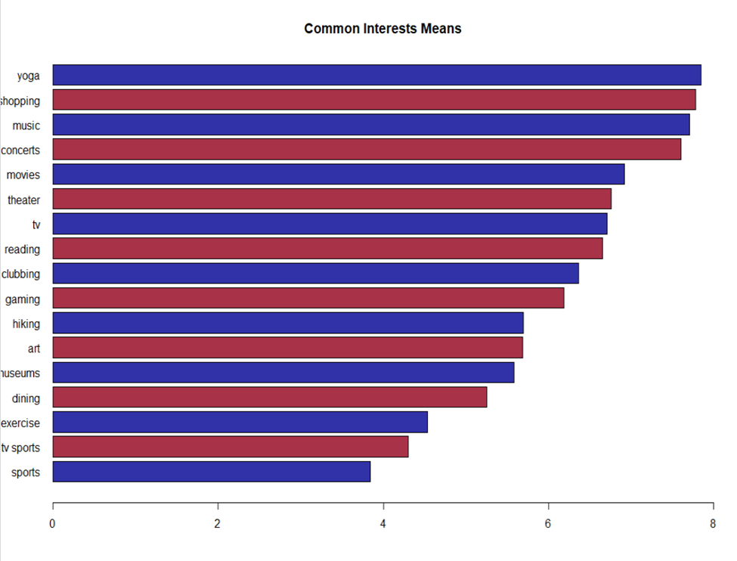
Interests
I was curious to see what the individual means were for each of the categories
I first looked at total mean with matches and non matches, then I split the data and measured the means again
We can see that the most popular interests in the set of people are yoga, shopping, music and concerts.

Slide 11
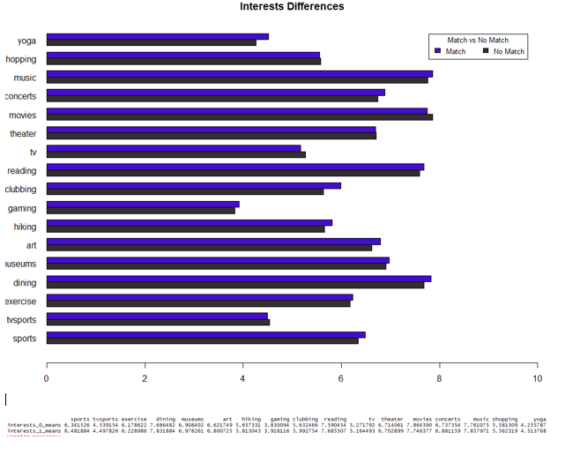
interests
Now when we split of the data based off of whether there was a match or not, we can spot a couple things
Interests between matches and non matches line up almost perfectly.
Our 2 subset groups have a lot of the same interests

Slide 12
Survey Responses
Each of the participants were asked to rate their dates on 6 attributes
Participants had to fill out these answers if there was a match or not
I believe we can get some great insights to see what attributes stood out the most
Keep in mind that each of these dates were only 4 minutes and participants were asked to rate their date on these 6 attributes on a scale from 1-10
The 6 attributes are as follows
Attractiveness
Sincerity
Intelligence
How fun the person is
Ambitiousness
Shared interests

Slide 13
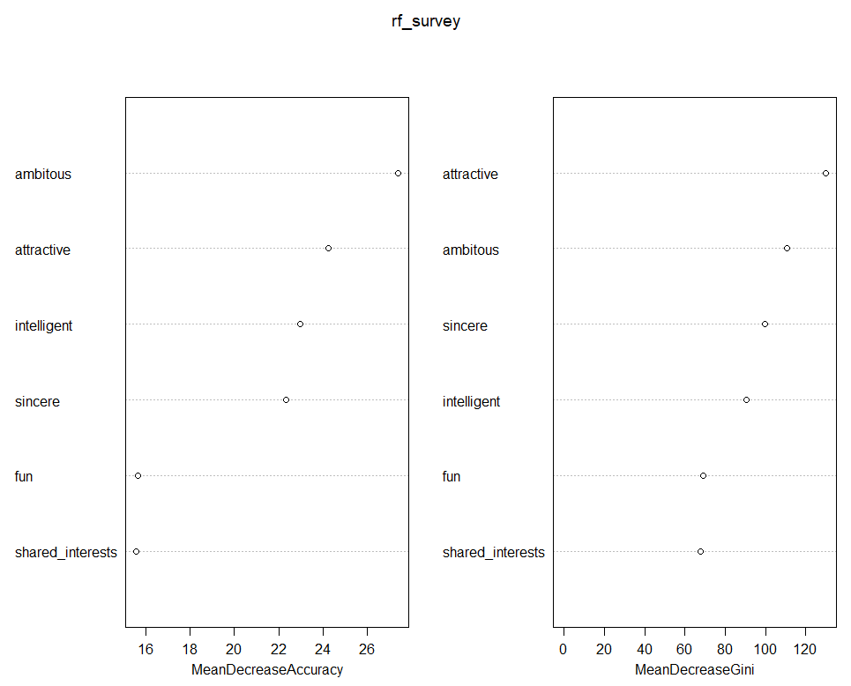
Survey Responses
Our Random Forest Model yielded a 97.11% accuracy
I believe that this subset of data was the most telling of when instanced were matches
We can get a true insight of what people were looking for in choosing a partner.
Based off our Random Forest model, ambitiousness and attractiveness were consistently the 2 most impactful independent variables in determining our results for a match

Slide 14
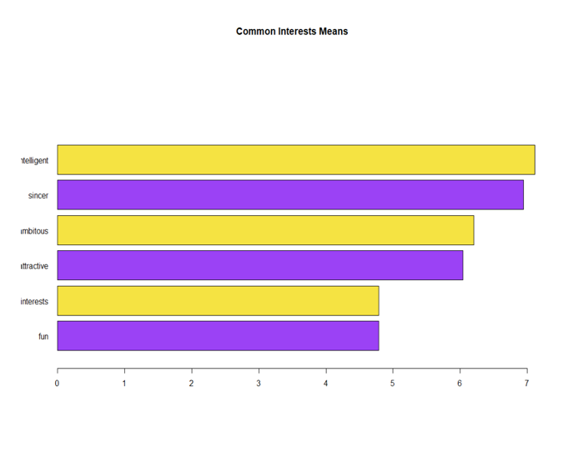
Survey Responses
Similarly to how we observed interests, I wanted to look at the total means of matches and non matches.
Here we can see that intelligence and sincere were generally rated the highest among all participants for their date
Common interests and fun were rated the lowest.
Now we can split the data and see what the differences are and how much impact it had on total means

Slide 15
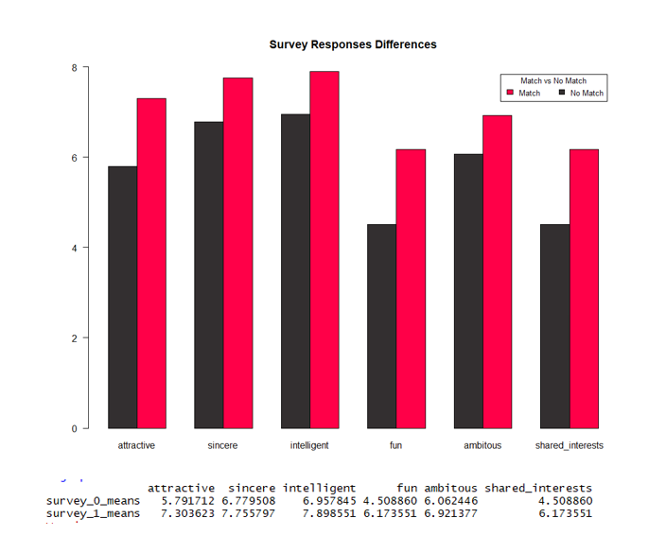
Survey Responses
Here are the means split up in cases where there are match vs no match
Couple insights we can clearly make are that matches were rated higher in all categories, clearly
The biggest take away to me is that how fun their date was and shared interests show the largest difference, and those 2 same columns were the lowest when we looked at all data in the last slide

Slide 16

Conclusion
There are many things to consider when analyzing our dataset on determining cases of matches or non matches
Demographics and survey results proved to be the most impactful
We were able to observe which independent variables were most impactful to our machine learning model
Observing the data as a whole helped us get better insights before splitting it into our match vs nonmatch
Thank you for taking the time to view my presentation, I hope you enjoyed it!
This Photo by Unknown Author is licensed under CC BY

Slide 17
REFERENCES
“Speed Dating Experiment - Dataset by Annavmontoya.” Data.world, 16 Aug. 2016, data.world/annavmontoya/speed-dating-experiment/workspace/project-summary?agentid=annavmontoya.
robk@statmethods.net, Robert Kabacoff -. “Bar Plots.” Quick-R: Bar Plots, www.statmethods.net/graphs/bar.html.
David. “How to Clean Messy Data in R.” R For the Rest of Us, 10 Dec. 2019, rfortherestofus.com/2019/12/how-to-clean-messy-data-in-r/.

